Slide 1
We’ll Be Starting Shortly!
To help us run the workshop smoothly, kindly:
Submit all questions using the Q&A function
If you have an urgent request, please use the “Raise Hand” function

Slide 2
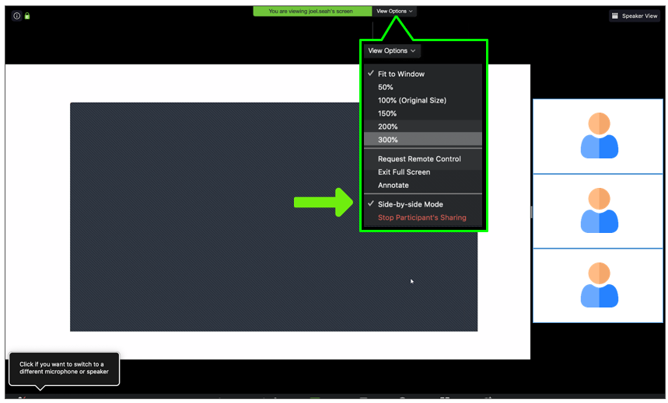
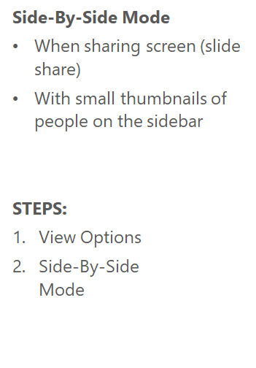
Using Zoom: Viewing Mode

Slide 3
Sentiment Analysis
With Tensorflow
Tom Huynh, 2021
Notes:
Reaching your pockets hopefully your phone's still there our phones do a lot for us they check the weather, turn on the alarm for work, check social medias, connect us with friend and family,
But there's one thing our phones can't do yet is to tell us how we do feel.
hey siri how am i doing today
okay google how are my emotions today
see these seem like silly questions
but with advancements in sentiment analysis and machine learning, this is actually possible right now
Hi, Welcome to the workshop of Sentiment Analysis with Tensorflow
If you are not the expert of ML or AI, dont worry
We gonna teach you the tuition of the concepts of this topic
And show you how to code it done line by line
Also, provide you extra materials to do your own research
1 minute

Slide 4


Meet Tom Huynh
Director of Machine Learning at Coderschool
Former Head of Web Development at Weboptimizers, Melbourne
Google Certified Tensorflow Developer for Deep Learning/Machine Learning
Master of AI/Machine Learning, UNSW, Sydney
Bachelor of Computer Science, University of Melbourne, Australia
Winners and Runner-ups of multiple Startup/AI/Tech Hackathons
Notes:
First, let’s meet up Tom Huynh which is me
…
Alright, that is enough about me
Very nice to meet you all and share some insights about this very interesting topic of sentiment analysis
50 second

Slide 5

Who is Coderschool?
CoderSchool is an organization that drives frontier technologies in Vietnam through education.
Provide both online and offline coding courses, mentorship, and job placement for our students and alumni.
Notes:
Right now, you might be asking yourself, who is Coderschool
20 seconds

Slide 6
Kick-start Your Tech Journey With Us!
For Machine Learning lovers:
Machine Learning & Data Science (online/offline and full-time/part-time)
Data Analysis (part-time)
For aspiring Web Developers:
Full Stack Web Development (online/offline and full-time/part-time)
100% Job Guarantee for beginners with no coding experience:
For more information, please contact us!
Are you ready?
Email us at apply@coderschool.vn
Or call us at (+84) 984 326 569
Notes:
If you got no experience in coding, want to learn about coding or just want to improve your current tech skills then
Kick start your tech journey with us
We have two main subjects: data science/machine learning and web development
With machine learning: we got the data science course with different flexible options for you: online or offline, full-time or part-time
Also, we got a short-term course data analysis for part-time people
With: we got the web development course with similar options for you: online or offline, full-time or part-time
We are very serious about our job so we promise our students with 100% job guarantee because
[NEXT SLIDE]
45 seconds

Slide 7
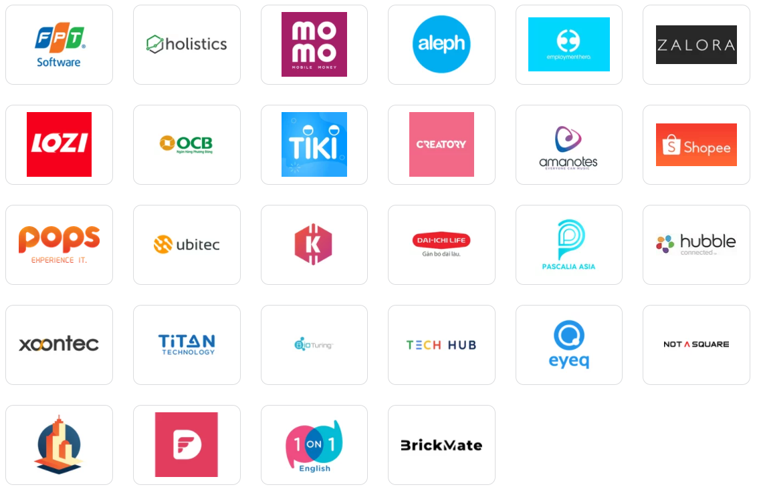
Our client base
Notes:
We got up to 200 hiring companies in Vietnam
Dedicated team for student outcome to support : folio, resume, final project, interview questions so you can land your dream jobs.
In short, if you don’t know where to start: coderschool will guide you from the start to the end.
20 sec

Slide 8
What I hope you take away from this
What is Sentiment Analysis
Why it is very important to business and society
What is the general pipeline for preprocess text
How to represent words for computer to process (Tokenization)
What is Word Embedding Vector
Basic understanding of deep neural network
Build a deep learning model using Tensorflow (lab)
Notes:
There are a variety of natural language processing techniques out there and then one I'll be talking about in this workshop is sentiment analysis
Here are a few key takeaway from today workshop:
...
I know it looks like the agenda list to learn rocket science but trust me it it quite straightforward and intuitive
1:20 minutes

Slide 9

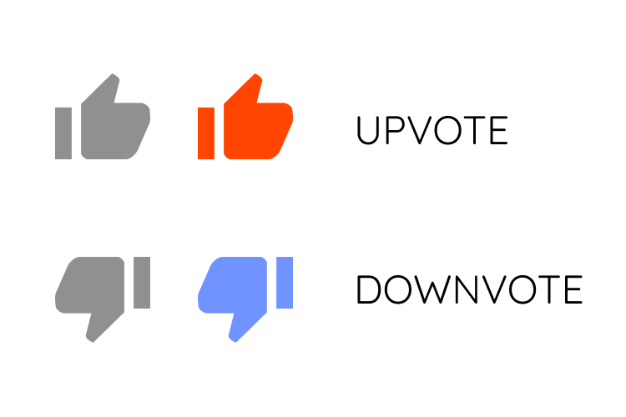






Let’s think about a scenario
Text: “My beanie is amazing!...” Length: 120 words
Text: “My shirt got wrong color!...” Length: 300 words
Text: “The size of the shirt is really odd!...” Length: 20 minutes
Text: “The new beanie feel really warm!...” Length: 40 words
Notes:
Here is the real world challenge for today
Let’s think about the scenario
so let's say you are a manager of a company that sells hats and also shirts
and you want to know what your customers are thinking about your hats and shirts
do they have positive feelings about them or negative feelings about them
so then you go to your call center and check out your social media
and you see that a bunch of people have called in or post on the media about your hats and your shirts
and you could go through all of these by listening or reading to every single message but that would take you a really long time
It’s estimated that 90% of the world’s data is unstructured, in other words it’s unorganized. Huge volumes of unstructured business data are created every day: emails, support tickets, chats, social media conversations, surveys, articles, documents, etc). But it’s hard to analyze for sentiment in a timely and efficient manner.
so instead you can use an ML model to automatically tag these as positive or negative comment about your product
and then at the end of the day you can figure out that people tend to think that
your hats are pretty good and that your shirts are not very good
so this concept is called sentiment analysis
1:20 secs

Slide 10
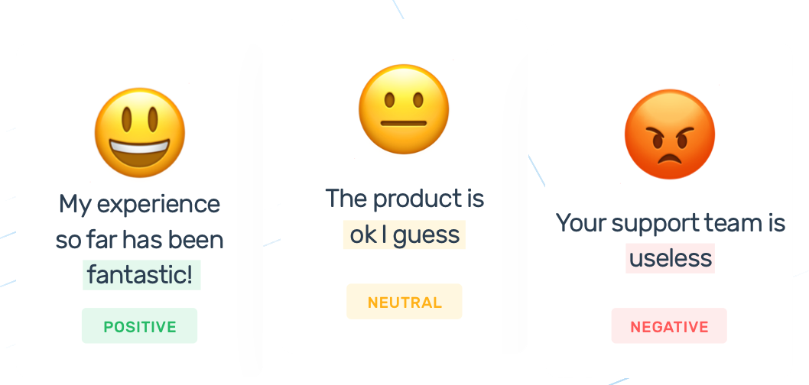
Sentiment Analysis
The process of determining the opinion or feeling of a piece of text (positive, negative or neutral.)
Notes:
Sentiment analysis is the process of detecting positive or negative sentiment in text.
Sentiment analysis models focus on polarity (positive, negative, neutral) but also on feelings and emotions (angry, happy, sad, etc), urgency (urgent, not urgent) and even intentions (interested v. not interested).
So the output of the model depends on the task you want to achieve
Sentiment analysis is one of the hardest tasks in natural language processing because even humans struggle to analyze sentiments accurately. “This is better than nothing.”
1:25 secs

Slide 11



Why is Sentiment Analysis important?
Brand Reputation & Product/Service Monitoring
Customer Service
Market Research
Social Purposes
Notes:
Brand Monitoring Product Performance/New Policy Monitoring Social Media Monitoring
Sentiment analysis is extremely important because
it can help a business to understand the social sentiment of their brand, product or service while monitoring online conversations on social media, across the internet, on news sites, blogs, forums, product reviews, and more.
For example, using sentiment analysis to analyze thousands of reviews about your product could help you discover if customers are happy about your pricing plans and customer service.
Again, we can look at not just the volume of mentions, and overall quality of those mentions.
[Customer Service] Next Slide
Market Research
Sentiment analysis empowers all kinds of market research and competitive analysis.
Exploring a new market, anticipating future trends
Gaining insight into customer opinions once you understand how the customer feels
what they liked and disliked
and built things like recommendation systems or targeted marketing campaigns for them
Follow your competition in real time on social media.
Maybe your competitor released a new product and no one buy them
Find out what aspects of what went wrong and use it to your advantage.
Social Purposes
Can help for people with mental health issues
Many people with these issues spend a lot of time in the internet
and so with this technology we'll be able to provide help for people by identify them with dangerous behaviors
make the internet safer for us all
then it can become a therapist for all of us
With all of the benefits above, I hope you’re convinced sentiment analysis can make all the difference in the world.
4 minutes

Slide 12


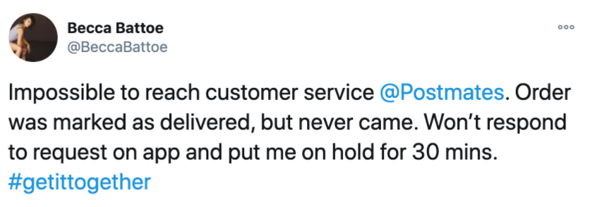
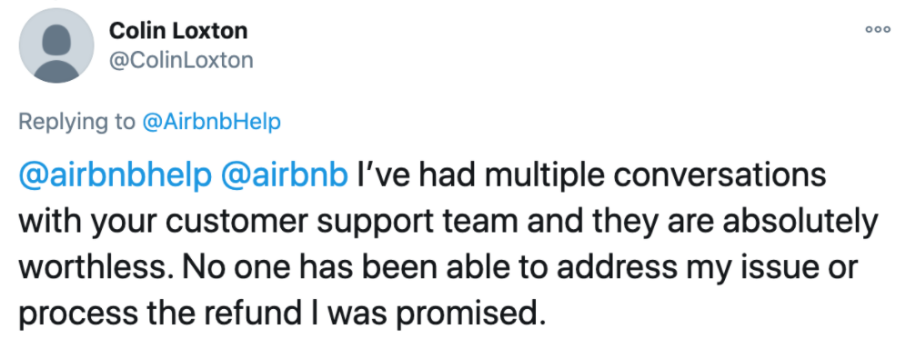
Examples
Notes:
Customer Service
Better customer experiences means a higher rate of returning customers.
Customers expect their experience with companies to be immediate, intuitive, personal, and hassle-free.
If not, they’ll leave and do business elsewhere.
Did you know that one out three customers will leave a brand after just one bad experience?
...
Can identify urgent issues in real-time to avoid PR crisis by taking action right away.
[Go back slide]

Slide 13

The process of sentiment analysis
Input
(Corpus)
Preprocessing
Train ML Model
(Deep Neural Network)
Predicting the sentiment of new text
Tokenization
Padding
Notes:
You know what is sentiment analysis, and why it is very important
And now you want to know how to build a sentiment analysis model
I’m here to help
Here is the simple diagram of the whole pipeline we gonna build today
First, you got the input (which is a millions of text) we call it corpus
Then, to prepare it to be ready for the ML model we need to preprocess it
This step can be complicated so i will keep it simple and only talk about tokenization and padding
Tokenization where you turn letter or words into numbers
Padding is to add a bunch of zeros to make sure all sentences got the same length
Then it plug it through the ML model which we gonna use Neural Network model
After training model for a few times on the whole corpus
We can use it to predict a new sentence for sentiment as simple as that
Now let’s talk about each component in the diagram
1:10 minutes

Slide 14
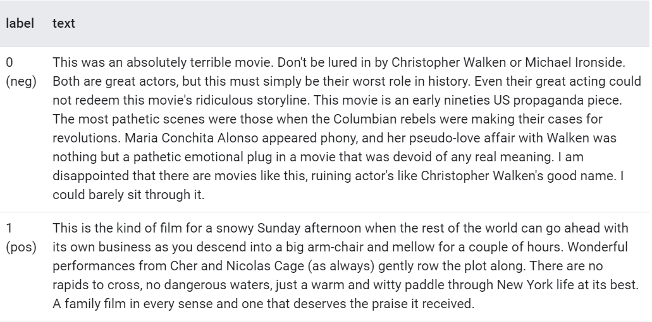
IMDB Movie Review Dataset
Text (corpus):
25,000 movie reviews from IMDB website
Label (expected output):
0 means negative sentiment
1 means positive sentiment
Split Training/Test:
25,000 for training
25,000 for testing
Notes:
First, let’s talk about our input. We gonna use IMDB Movie Review Dataset
There are two columns (text and target) with 25,000 rows or samples
Text: 1 million tweets on the twitter from different users websites
Label column is the sentiment of the tweet:
0 means negative sentiment
1 means positive sentiment
This information is crucial because it is how we train our model
To train the ML model we need to tell the model if you see this sentence to suppose to be 0/ negative or 1/ positive
This is pretty much what you expect anyways
45 sec

Slide 15
How do we turn sentences into number?
(Tokenization)
Notes:
Machine learning models take vectors (arrays of numbers) as input. When working with text, the first thing you want to do is to figure out a strategy to convert strings/text to numbers (or to "vectorize" the text) before feeding it to the model.
Let’s discuss a few methods to achieve that!
20 sec

Slide 16
How can a text be understood by a computer?
There are two main ways to tokenize a text:
Each letter
Each word
Notes:
The process of encoding string/text into numbers so that later the neural network can understand their meaning
we can call this process tokenization
Here are two ways to tokenize a text:
Letter by Letter
Word by Word
Which way is better?
Let’s discuss the first way which is to tokenize each letter of a sentence
30 secs

Slide 17
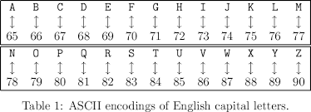
Tokenize a letter
Let’s start with a very naive way to tokenize a letter to be understood by a computer
Notes:
Let’s start with a very naive ...
A popular and classic way for a computer encode and display a letter called ASCII which is character encoding standard
You can see that these letters can be represented by numbers using this encoding scheme.
20 sec

Slide 18
Example tokenize letter using ASCII
L I S T E N
76 73 83 84 69 78
Notes:
Consider the word "listen”
It's made up of a sequence of letters.
These letters can be represented by numbers using this encoding scheme.
Let’s try to figure out this word can be represented by which sequences of numbers
Try for 2 minute:
[Quiz] 76, 73, 83, 84, 69, 78
This bunch of numbers can then represent the word “listen”
1 minutes + 2 minutes [quiz]

Slide 19
Example tokenize letter using ASCII
S I L E N T
83 73 76 69 78 84
Notes:
Consider the word "silent," as you can see here.
Quiz [2 minutes]
83, 73, 76, 69, 78, 84
It's made up of a sequence of letters.
2:30 minutes

Slide 20
Problems of Letter Tokenization
L I S T E N
76 73 83 84 69 78
S I L E N T
83 73 76 69 78 84
Notes:
From those two examples, we can see the problems of this letter tokenization approach
Lack of meaning:
the word “silent” and the word “listen” has the same letters, and thus the same numbers, just in a different order.
Unlike words, characters don’t have any meaning, so there is no guarantee that the result of this tokenization will be meaningful.
We'd run into a problem this method struggles to recognize the semantic/meaning similarity between words.
So it makes it hard for us to understand sentiment of a word just by the letters in it.
Increased input computation: Assuming in 7-word sentence, we have an average of 5 letters per word you now have 35 inputs to process. This increases the complexity of the inputs for the model need to process. But If you tokenize word by word, then in the 7-word sentence, will have 7 input tokens. Much small size for the model to process.
You can see there are a bunch of problems with letter tokenization so let’s discuss word tokenization
1 minute

Slide 21
Tokenize a word
I love my dog
01 02 03 04
Notes:
So instead of encoding letters, to encode words.
Consider the sentence: I love my dog.
So what would happen if we start encoding the words in this sentence instead of the letters in each word?
So, for example, the word "I" could be 1, and then the sentence "I love my dog" could be 1, 2, 3, 4.
30 sec

Slide 22
Tokenize a word
I love my dog
01 02 03 04
I love my cat
01 02 03 05
Notes:
Now, if I take another sentence, for example, "I love my cat,"
how would we encode it?
Now we see "I love my" has already been given 1, 2, 3,
so all I need to do is encode "cat."
I'll give that the number 5 because “dog” is already 4
And now, if we look at the two sentences, they are 1, 2, 3, 4 and 1, 2, 3, 5, which already show some form of similarity between them.
And it's a similarity you would expect, because they're both about loving a pet (dog or cat)
You've now seen how words can be tokenized
50 sec

Slide 23
Tokenize a word - not enough? Problem?
I love my dog
01 02 03 04
I like my cat
01 05 03 06
Notes:
Nothing is perfect. Even word tokenization is not enough. Let’s have a look at this example:
“I love my dog”
“I like my cat”
Love is 02 Compared to like is 05
Dog is 04 Compared to cat is 06
The numeric encoding like this is arbitrary and random
because it treat every word is independent with each other and it does not capture any relationship between words.
The problem this method struggles to recognize the semantic similarity between words
for example this method fails to recognize similarity between a word such as “love” and “like”
compared to a low similarity/opposite meaning between “love” and “hate”.
So how can we improve our word tokenization so it can capture relationship between different words?
We need to add the word embedding vector on the top of our word tokenization.
1 minute

Slide 24
Word Embedding Vector
“Okie but Unexciting!” - Tom
Y
Unexciting
[-0.5, 0.8]
Okie
[0.7, 0.6]
[-1, 0]
Bad
Good
[1, 0]
X
Notes:
But you might be wondering at this point, we've turned our sentences into numbers,
with the numbers being tokens representing words. But how do we get meaning from that?
How do we determine if something is positive or negative just from the numbers?
Well, here's where the context of embeddings come in.
Let's consider the most basic of sentiments. Something is good or something is bad.
We often see these as being opposites, so we can plot them as having opposite directions like this.
Or the phrase, "Okie," which is usually meant to plot something as having a little bit of goodness
So then what happens with a word like "Unexciting"? It's not good, and it's not bad. Probably a little more bad than good. So you might plot it a bit like this. So it might look like this.
Now, if we plot this on an x- and y-axis, we can start to determine the good or bad sentiment as coordinates in the x and y.
Good is 1, 0. Unexciting is minus 0.5, 0.8, so on.
Consider what would have happened if I said something was "Okie but unexciting."
If we were to sum up the vectors and take the average, we'd have something that's 0.7 on y and 0.1 on x.
So its sentiment could be considered slightly on the good side of neutral.
Words that only appear in the negative sentences will have a strong component in the negative direction, and by versa.
By looking at the direction of the vector, we can start to determine the meaning of the word.
This concept is known as embedding.
Word embeddings provide us a efficient way determine which similar words have a similar encoding.
So what if you extend that into multiple dimensions instead of just two?
2 minutes

Slide 25
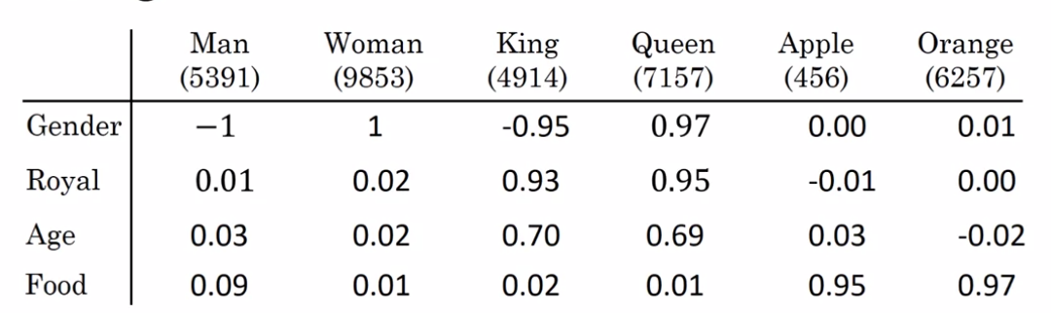
Simple Word Embedding Vectors
Notes:
Before we got two dimensions: Good or Bad.
Let’s extend that into 4 dimensions: Gender, Royal, Age, Food to describe these words we have: Man, Woman, King, Queen, Apple, Orange
Each word will be presented by a vector of 4 number (this vector we can call it to be word embedding vector)
...
If I put in apple and orange into my model I want those vectors to be very close to each other
because they're very related words, they are both fruits.
This kind of representations makes it possible for words with similar meaning to have a similar representation, which can improve the our model performance.
It is common to see word embeddings that are 8-dimensional (for small datasets), up to 1024-dimensions when working with big datasets.
A higher dimensional embedding can capture more details of relationships between words, but takes more data to train.
Importantly, you do not have to specify these number by hand. They are trainable parameters will be learnt during the training of the model.
2:30 minutes

Slide 26
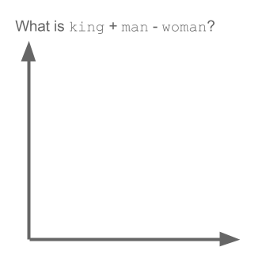
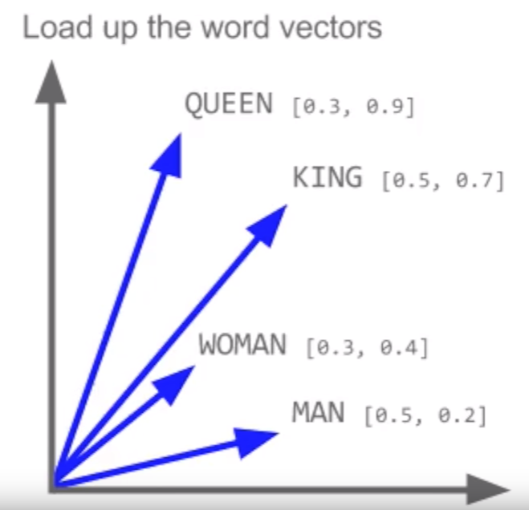
Relationships from Embedding Vectors
King - Man + Woman = Queen
King - Man + Woman = ?
Notes:
Here is the example to prove to you that these word embedding can capture semantic relationships between words.
Let’s plot the word embedding of Queen, King, Woman, Man in into 2 dimensional space.
These numbers are taken from a embedding layer in our model after it is trained.
Let’s ask you guys a question:
If someone is like a king, but not a man, and is a woman, who is that?
We can describe that into a math question like this: King - Man + Woman = ?
Most people will say it is Queen
We can show the answer by apply simple math for vectors like this.
[Gif]
2 minutes

Slide 27
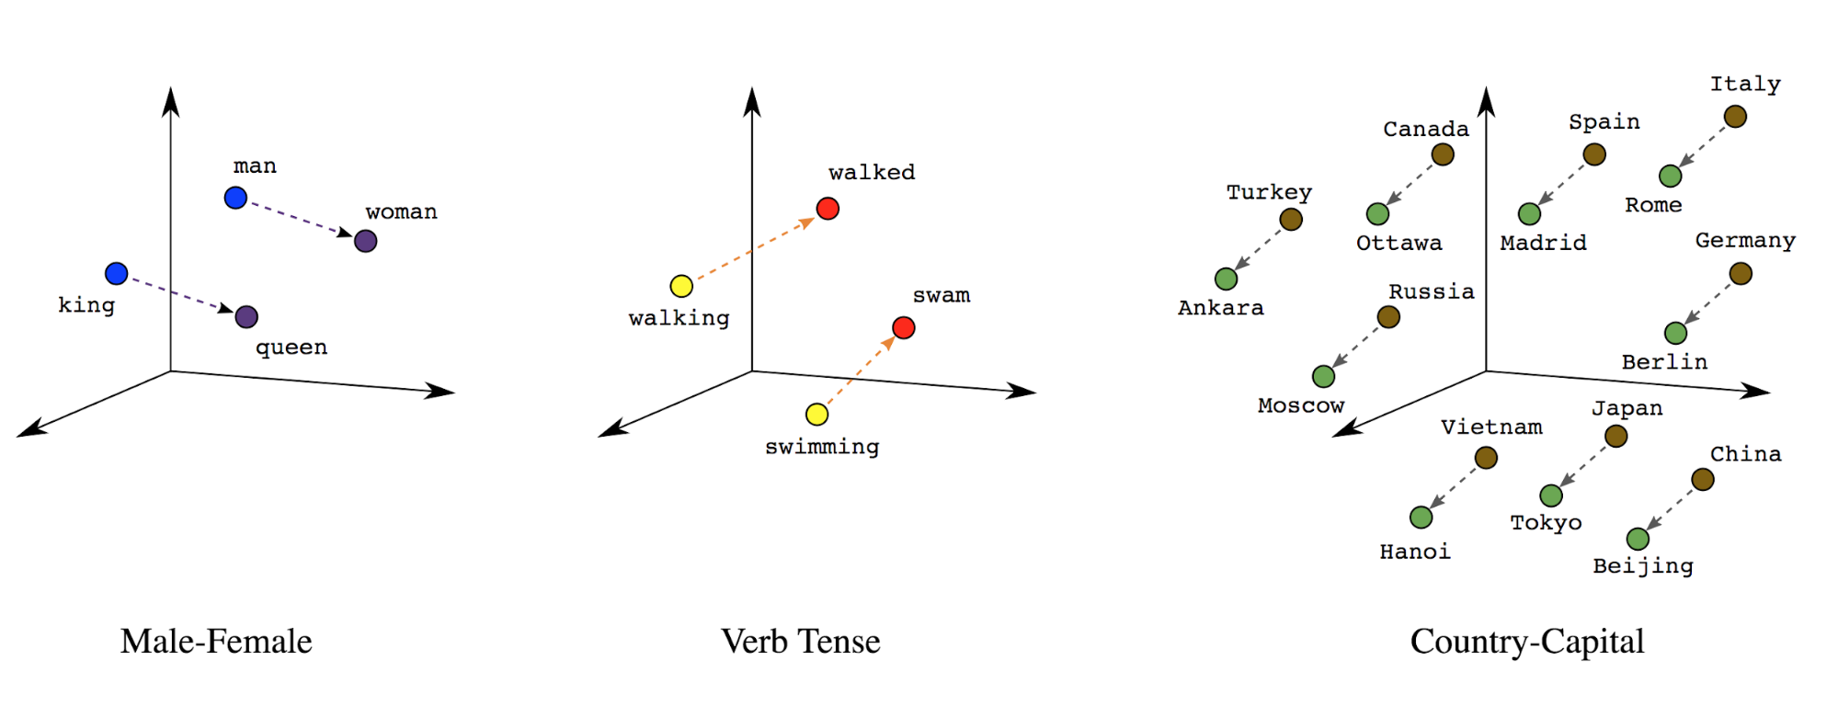
Relationships in Word Embedding
Notes:
The same logic applied for other relationships:
The difference/relationship between man and woman is like the relationship between king and queen
The relationship between walking (present tense) and walked (past tense) is like the relationship between swimming and swam
Or the relationship between country and capital like these.
This is how machine understand the concepts of relationships in words.
This is really amazing because as human to understand the relationship of words, we need to read the definition of those word in a dictionary.
But for machine, it can understand that pretty well just by encoding them in vectors and numbers. Just like that!
50 seconds

Slide 28
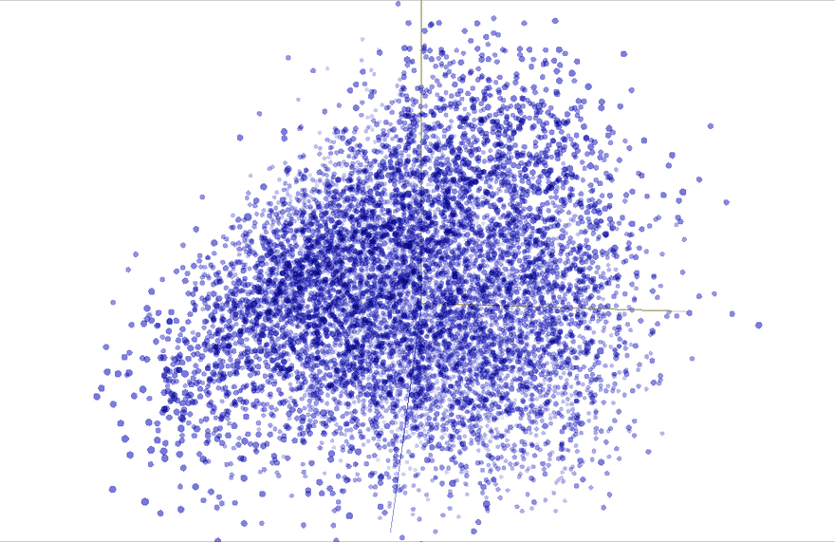
Embedding Vectors of 10,000 words for 200 dimensions
http://projector.tensorflow.org/
Notes:
Here is the real life example of 10,000 words for 200 dimensions after training the model.
For the purpose of visualization like this, we can use PCA to reduce 200 dimensions to 3 dimensions.
Each of the dot is a embedding vector of a word in 3D space.
You can click to this link to check it out: http://projector.tensorflow.org/
30 second

Slide 29
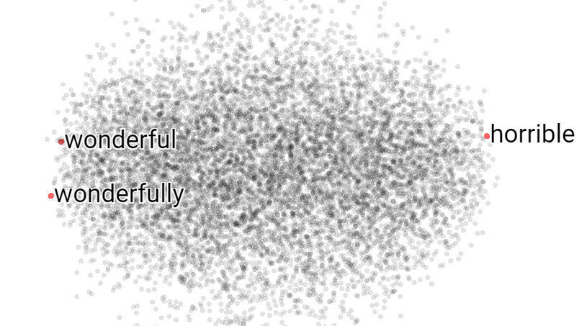
Word Embedding Space in Sentiment Analysis
Notes:
Extreme sides

Slide 30
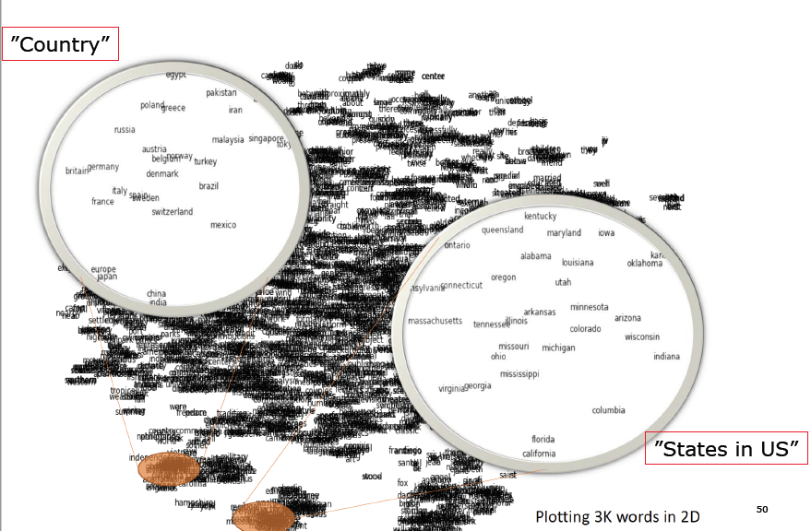
Word Embedding in general data
Notes:
Zoom in closely to this word embedding space
Words have similar meaning tends to be together
Country
States

Slide 31
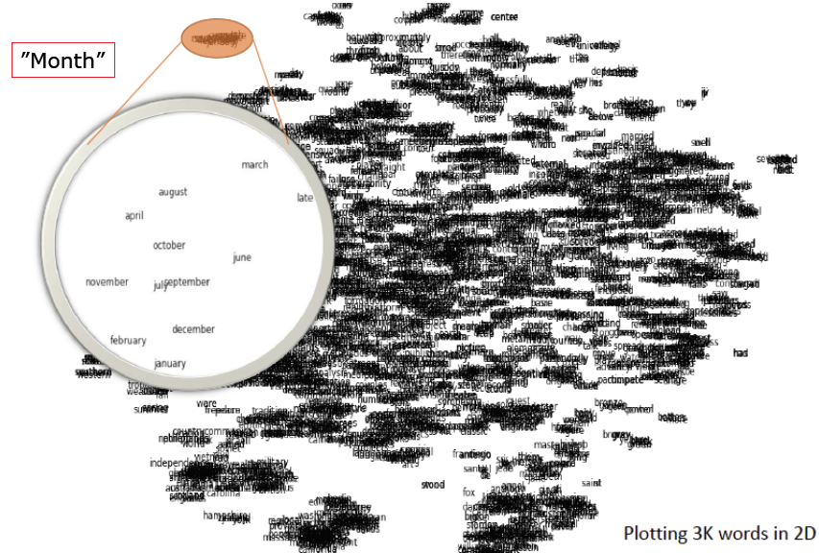
Word Embedding in general data
Notes:
Months of the year
38 sec

Slide 32
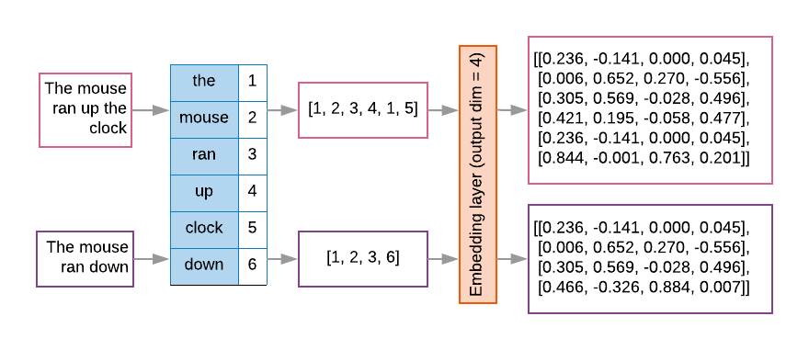
The Pipeline of Tokenization and Embedding Layer
Notes:
Different sentences
After tokenization, you have a word dictionary
that map a word into a numeric token
Each of these numeric token are corresponding to word embedding vector (in this case, the dimension we choose is 4)
Each of the word token will give you back 4 dimension vector.
At first, the numeric values of this embedding layers are random
Then we can feed these embedding vectors of sentences into our model model and the model will treat these as trainable parameters
Will update these numbers at every iteration during training till it is very good at the task
Which is predict sentiment of sentence in the training dataset.
We gonna use Tensorflow to get this done effortless.
1:20 minutes

Slide 33
Machine Learning Model
DATA
learn
MACHINE LEARNING
MODEL
predict
RESULT
Notes:
machine learning is simply like a function in math you give it one or many numbers and it give you back one or many numbers
At first, the result is pretty bad
But after many iterations during training, it will update the parameters so that it give you back the number closer to what you expect
After the training, you can use the model to predict a new sample
30 seconds

Slide 34
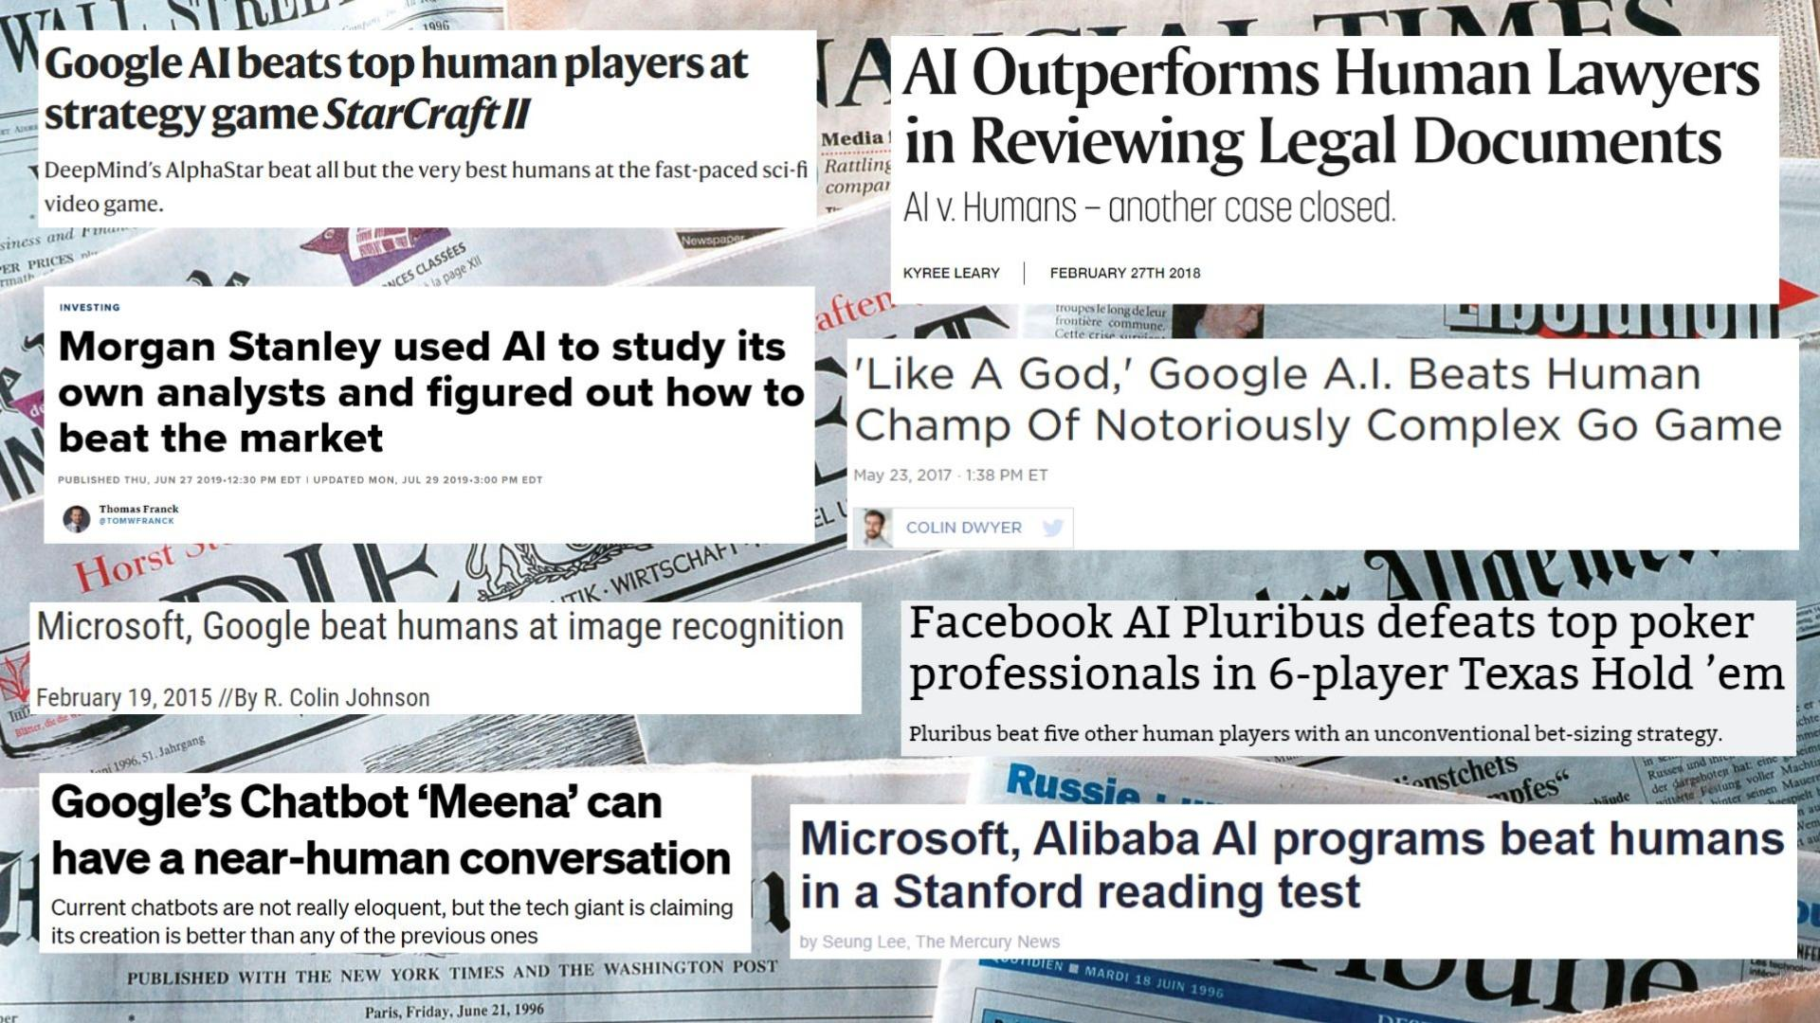
The Rise of Deep Neural Network since 2010
Notes:
This workshop i will focus on deep learning
Since this is what deep learning have achieved since 2010
…
So what is deep learning? Deep learning vs machine learning?
50 sec

Slide 35

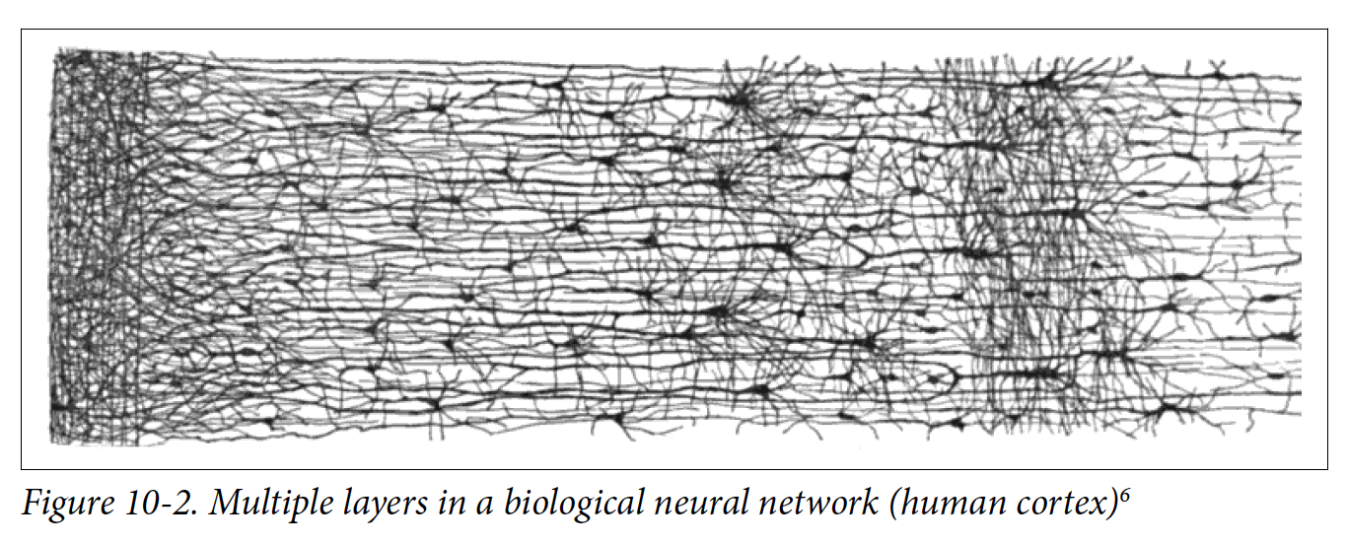
Deep Learning
Notes:
Deep learning is a machine learning model that inspired from a human brain,
Human neuron look like this Dendrite (as input), Axon(processing unit)
The input signal is stronger than a certain threshold, it gonna fire a signal out to synaptic terminal
…
50 sec

Slide 36
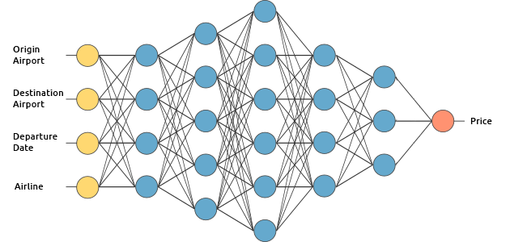
An Simple Example of Neural Network
Notes:
…
How it is related to sentiment analysis ?
1:10 minute

Slide 37
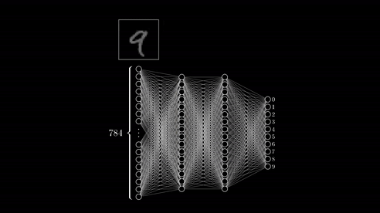
Neural Network in Action
Notes:
40 sec

Slide 38


Notes:
This demo we gonna be building a sentiment analysis program in Python using Tensorflow/Keras that will identify whether a movie review is positive or negative based on the text
TensorFlow, developed by Google, provides a low-level set of tools to build and train neural networks. There's also support for text vectorization, both on traditional word frequency and on more advanced through-word embeddings.
Keras is the high-level APIs for Tensorflow which makes building neural network super easy.

Slide 39
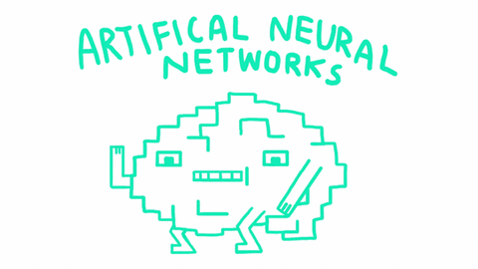

Hand-on Lab Link
https://bit.ly/3ezu6IP
Notes:
This step-by-step guide shows you how to train your first sentiment classifier.

Slide 40
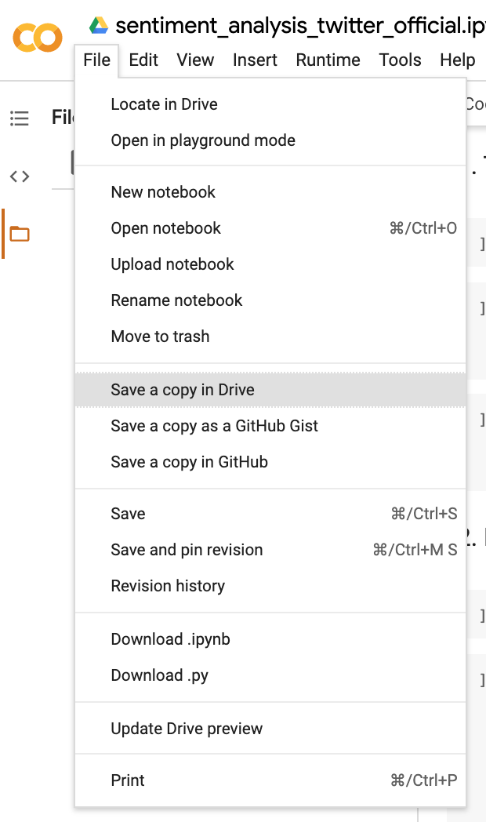
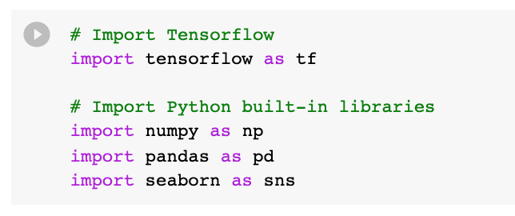
or Shift + Enter
Runtime — Change Runtime Type Hardware Accelerator — GPU

Slide 41

Thank you for your listening
Notes:
Sentiment analysis can be applied to countless aspects of business, from brand monitoring and product analytics, to customer service and market research.
Sentiment analysis has moved beyond from an interesting, high-tech stuff, and will soon become an essential tool for all companies of the modern age.
The technology is evolved so that it is effortless and too easy to implement a machine learning/deep learning model for that.
This is the best time to learn Machine Learning and Data Science since there are so much data available and so much potential of this technology can change the world and make the world the better place.
50 sec

Slide 42
Extra Datasets to play around
Twitter airline sentiment on Kaggle: https://www.kaggle.com/crowdflower/twitter-airline-sentiment
Amazon Product Reviews for Sentiment Analysis: https://www.kaggle.com/bittlingmayer/amazonreviews
Product Reviews: https://www.kaggle.com/bittlingmayer/amazonreviews
IMDB Movie Reviews: https://www.kaggle.com/lakshmi25npathi/sentiment-analysis-of-imdb-movie-reviews
Amazon Fine Food Reviews: https://www.kaggle.com/snap/amazon-fine-food-reviews

Slide 43
Extra Materials to learn NLP on Tensorflow
Word Embedding: https://www.tensorflow.org/tutorials/text/word_embeddings
Word2Vec: https://www.tensorflow.org/tutorials/text/word2vec
Text Classification with RNN: https://www.tensorflow.org/tutorials/text/text_classification_rnn

Slide 44

Your Feedback Matters!
bit.ly/3hmJ3Nr

